Slide 1
CS 170 Machine Learning Part 4
Notes based from Dr. Eamonn Keogh

Slide 2
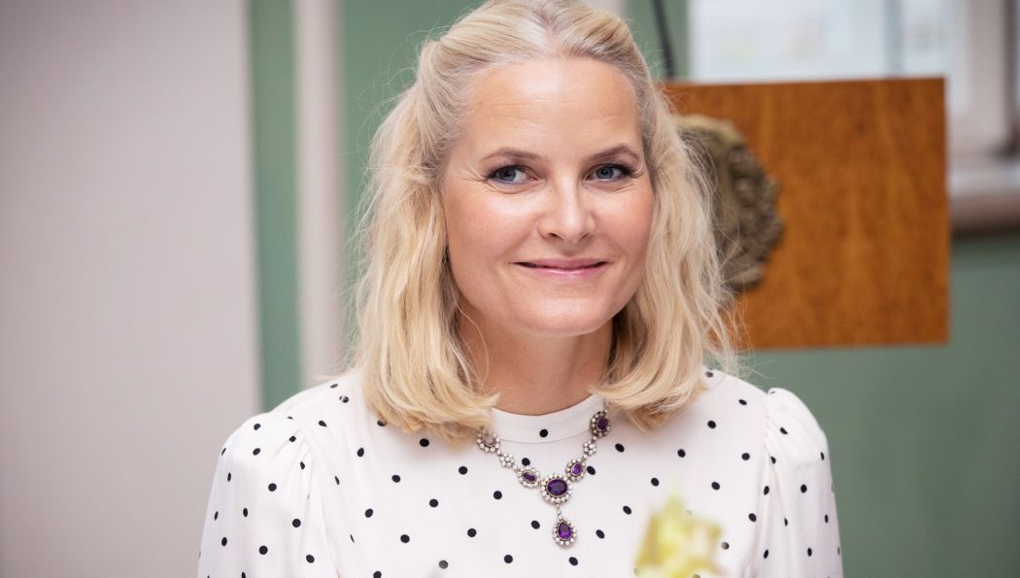


Motivation for Clustering
I get a call from my boss, asking me to pick up a Cambodian professor from the airport.
Before I can get any more details, my phone dies.
I know almost nothing about Cambodia, I have never met (to my knowledge) a Cambodian.
In the baggage claim area, there are only three people, which one should I approach?

Slide 3
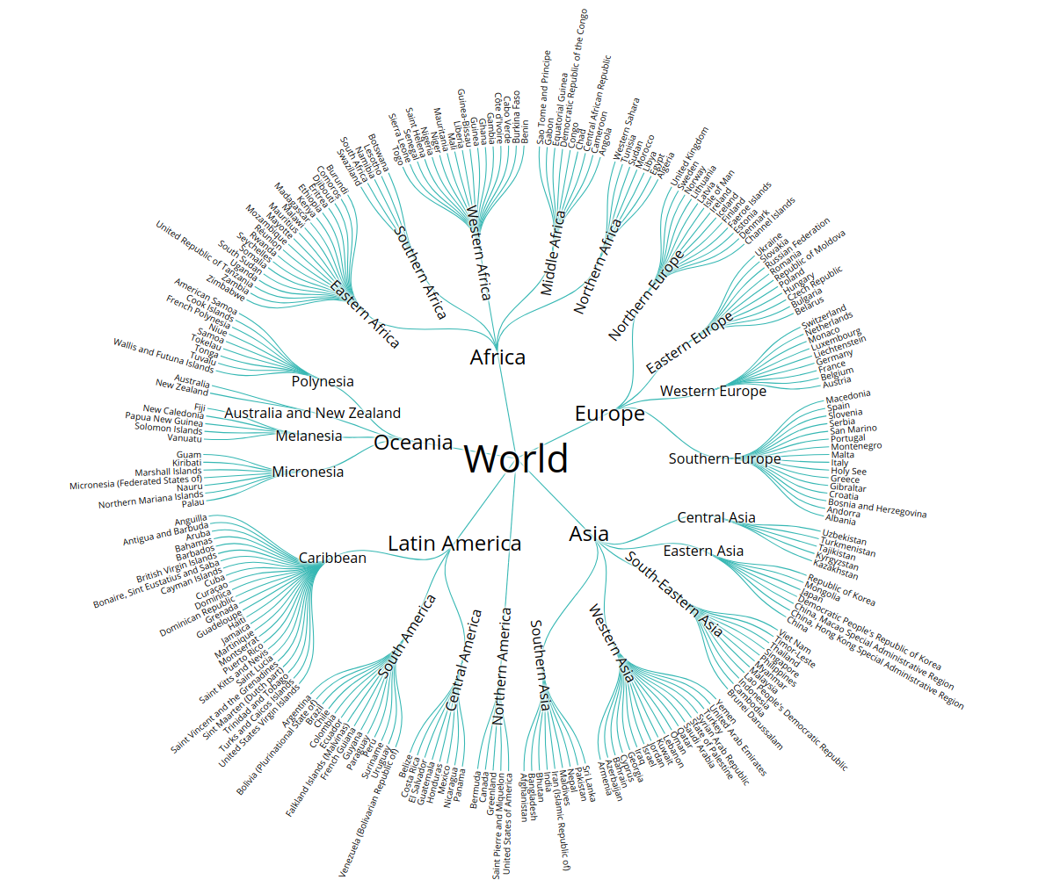
Over my life, I have implicitly built a “clustering” of all countries.
Because of physical/political geography, this clustering has a tree structure.
The root is planet Earth.
The major subtrees tend to be continents.
The next level down are regions, sometimes split by rivers or deserts.
The next level down are countries.
The next level down are counties/states.
The next level down…
Note:
I know some subtrees very well, mostly Europe and North America.
Other subtrees, such as Africa, Middle East, Asia, I know superficially.
Yet other subtrees, Caribbean, middle East etc., I know almost nothing about.

Slide 4
I know Cambodian is in the same subtree as Thailand
I didn’t know several Thai people
The lady in the middle looks like my Thai friends.

Slide 5
What religion is mostly likely for a person from Oman?
What religion is mostly likely for a person from Andorra?
Of course, hierarchical thinking can lead you astray..
What language do they speak in Paraguay?
I don’t know, but snice it is the South American
Subtree, and most of those counties speak Spanish
I will (correctly) guess Spanish.
What language do they speak in Guyana?
I don’t know, but snice it is the South American
Subtree, and most of those counties speak Spanish
I will guess Spanish. However, English is its official and most spoken language.

Slide 6
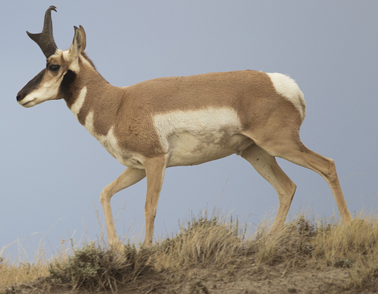
Clustering lets you reason about the world.
It allows you to generalize from incomplete information, to make predictions.
If you want to know a property of an object X. Place that object X into the cluster it belongs in, then use the most common property of that cluster to predict X’s property.
We probably do this, thousands of times per day (without realizing we are doing it).
For example, what does this animal eat? Fish, Carrion, Grass, Insects, Roots, Blood, Worms, Pollen, Wood, Fungus, Fruit, Tree Gum…..
Pronghorn

Slide 7
What is Clustering?
Also called unsupervised learning, sometimes called classification by statisticians and sorting by psychologists and segmentation by people in marketing
Organizing data into classes such that there is
high intra-class similarity
low inter-class similarity
Finding the class labels and the number of classes directly from the data (in contrast to classification).
More informally, finding natural groupings among objects.

Slide 8
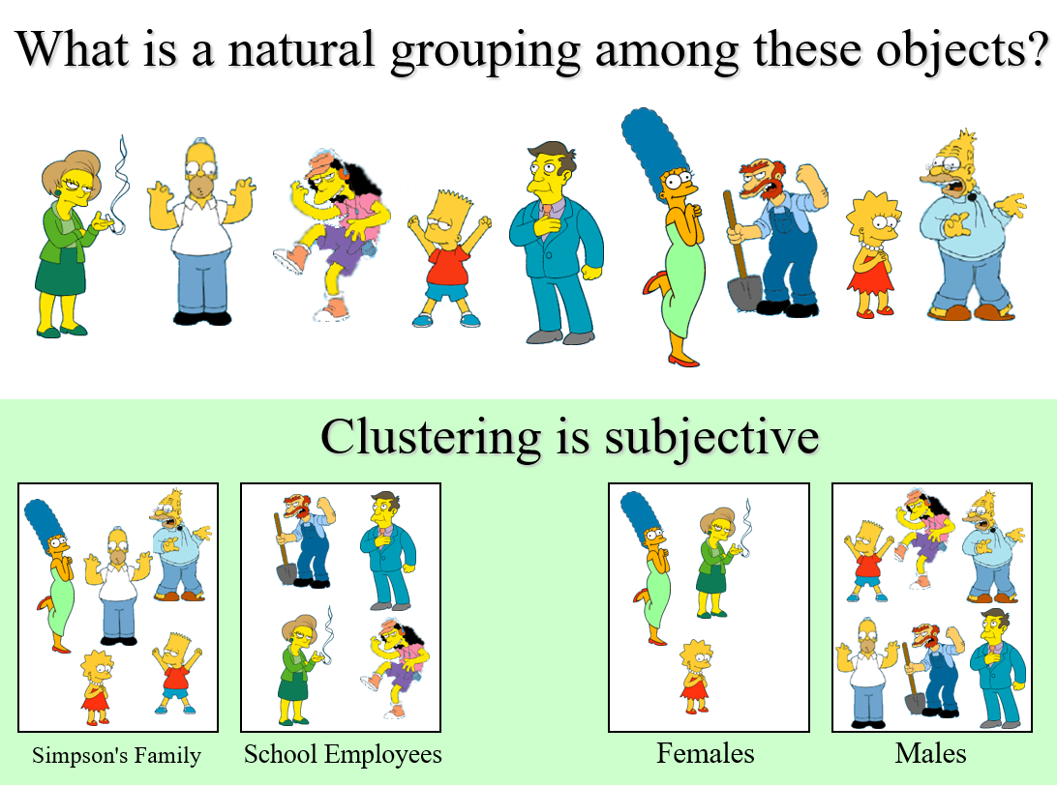

Slide 9
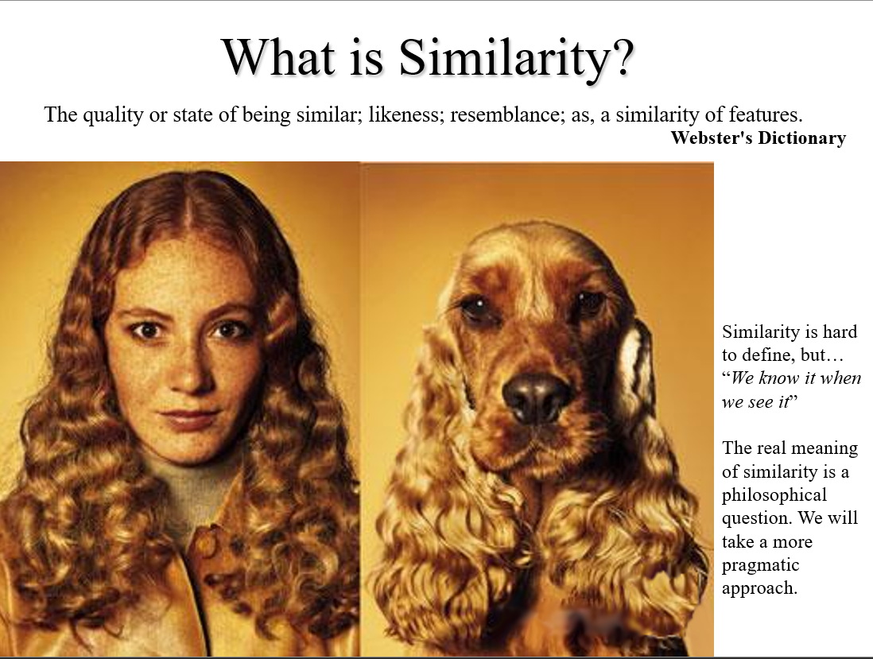

Slide 10
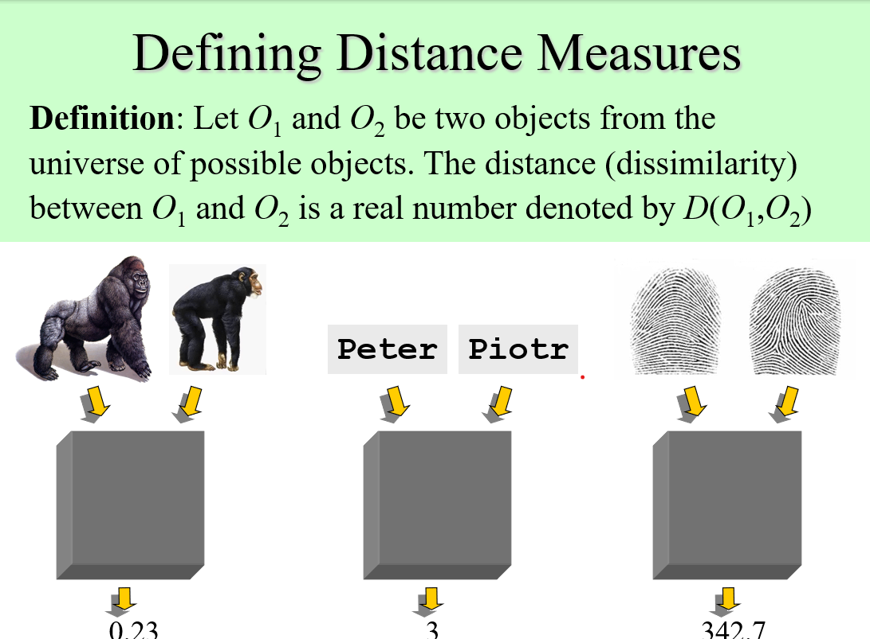

Slide 11
Imagine agriculture

Slide 12
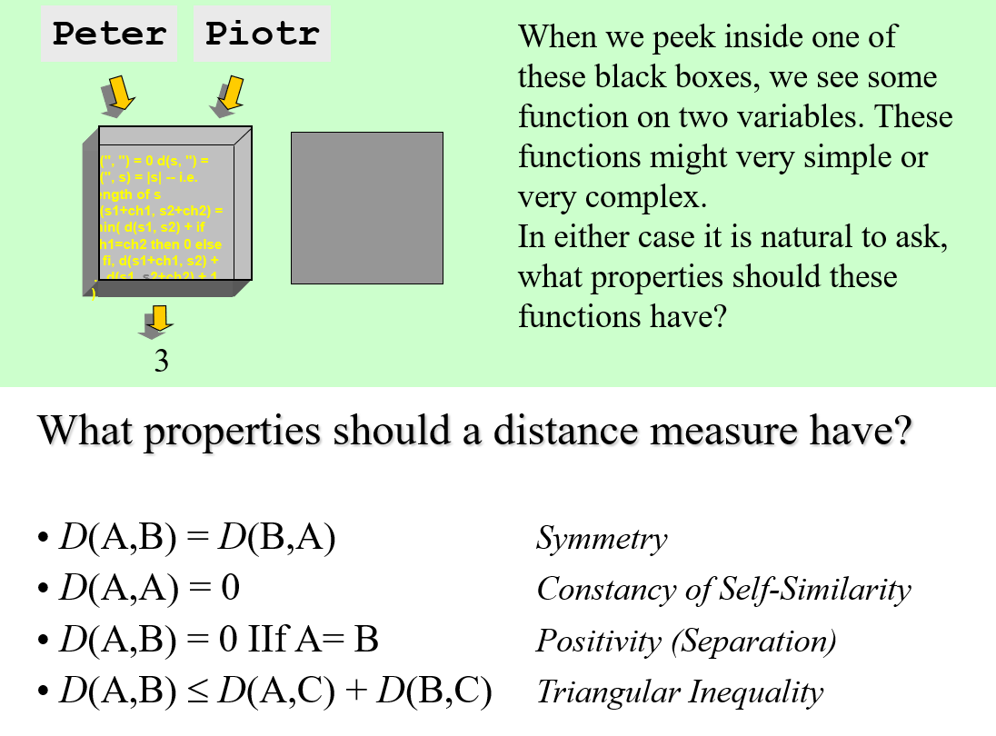

Slide 13
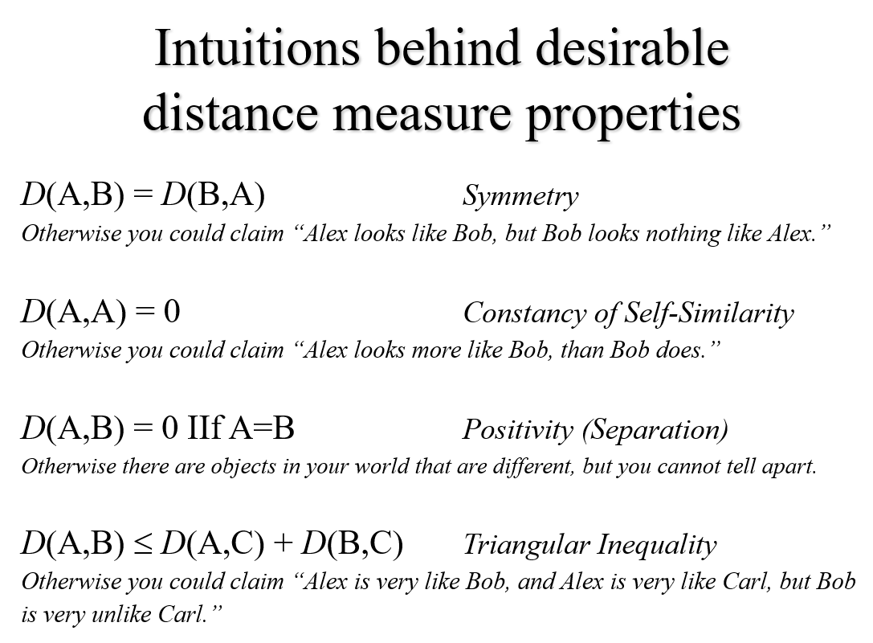

Slide 14
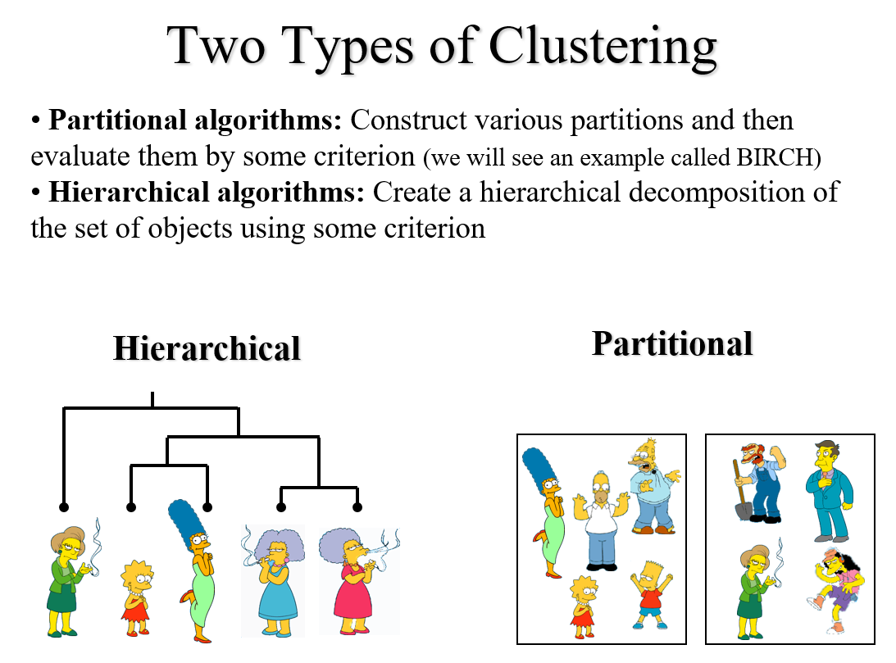

Slide 15
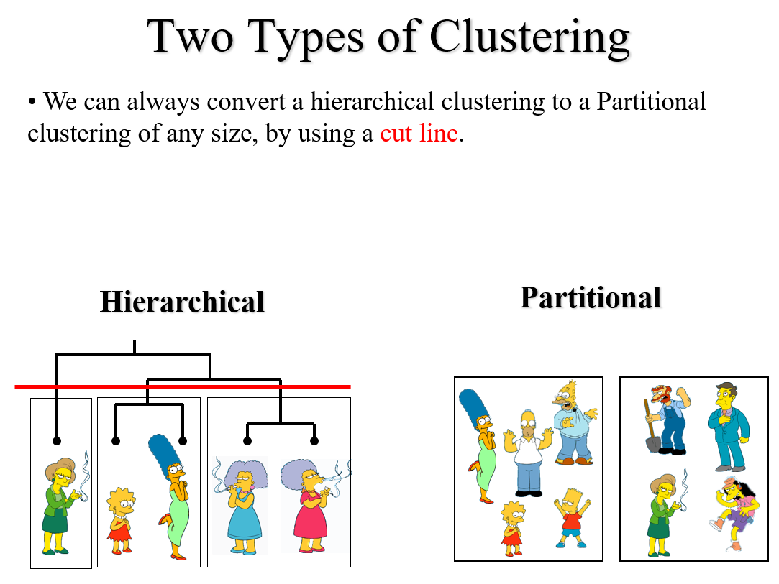

Slide 16
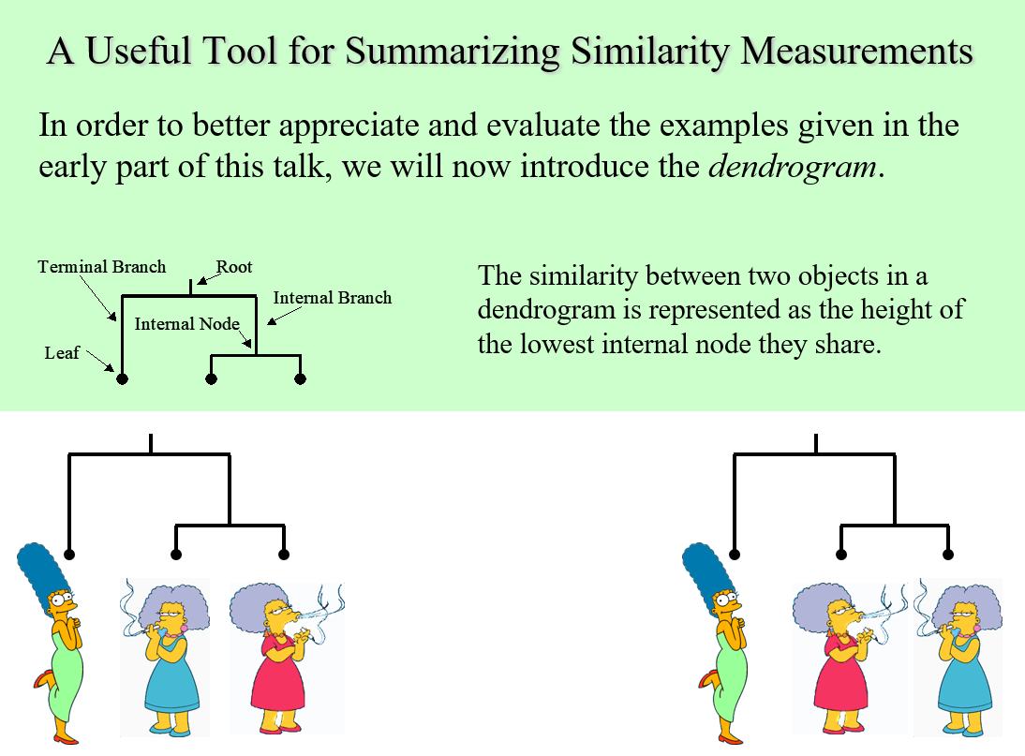

Slide 17
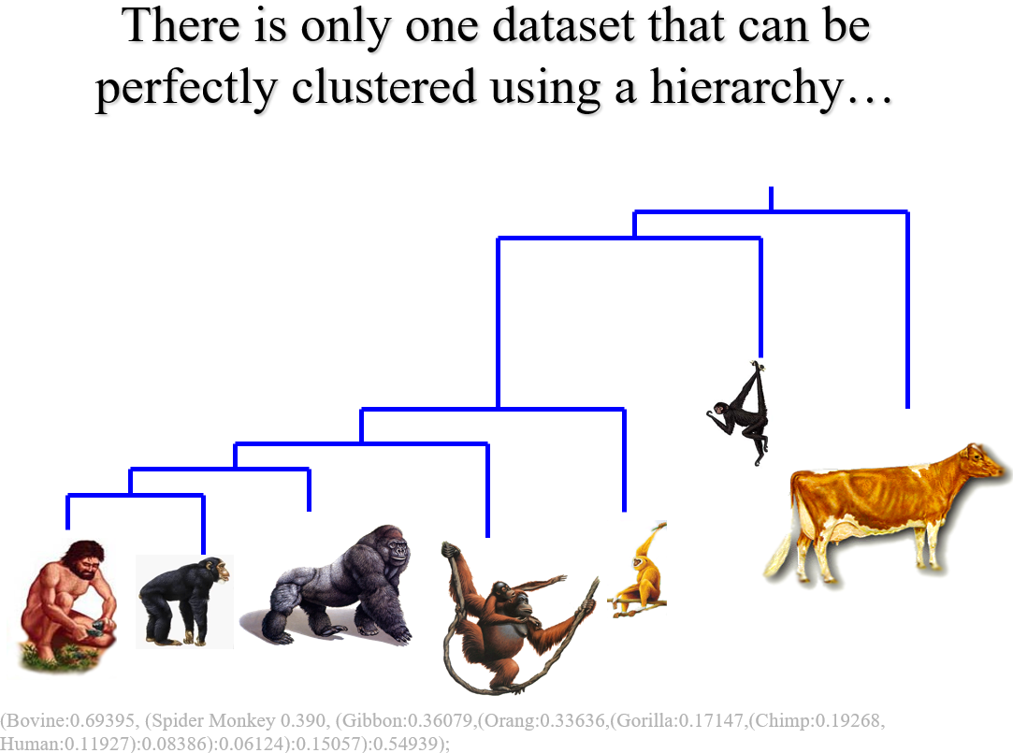

Slide 18
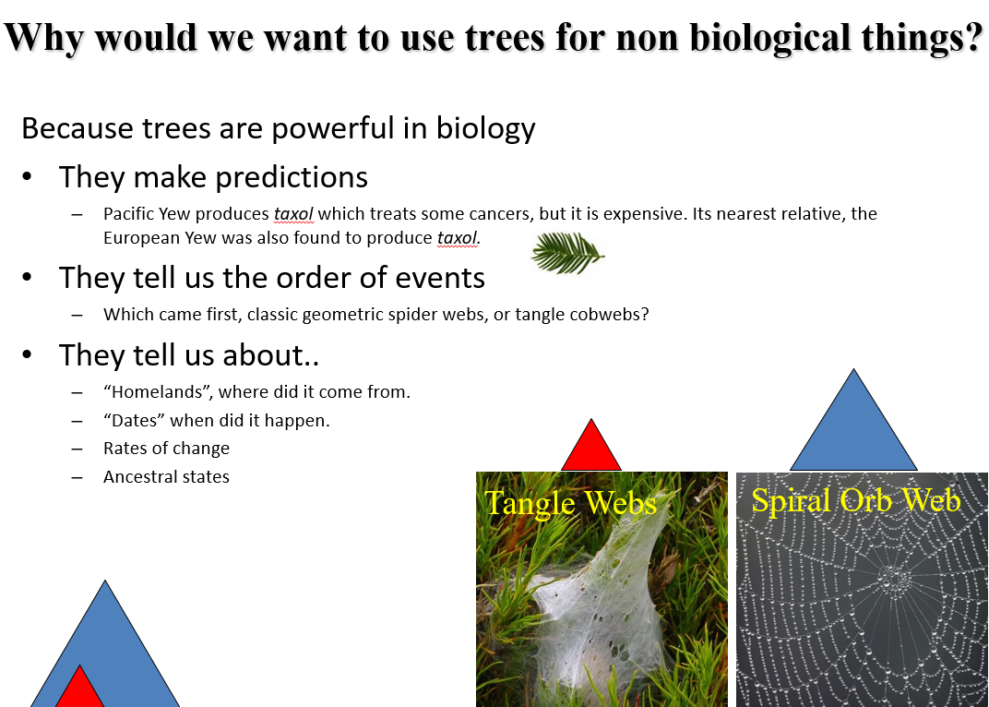

Slide 19
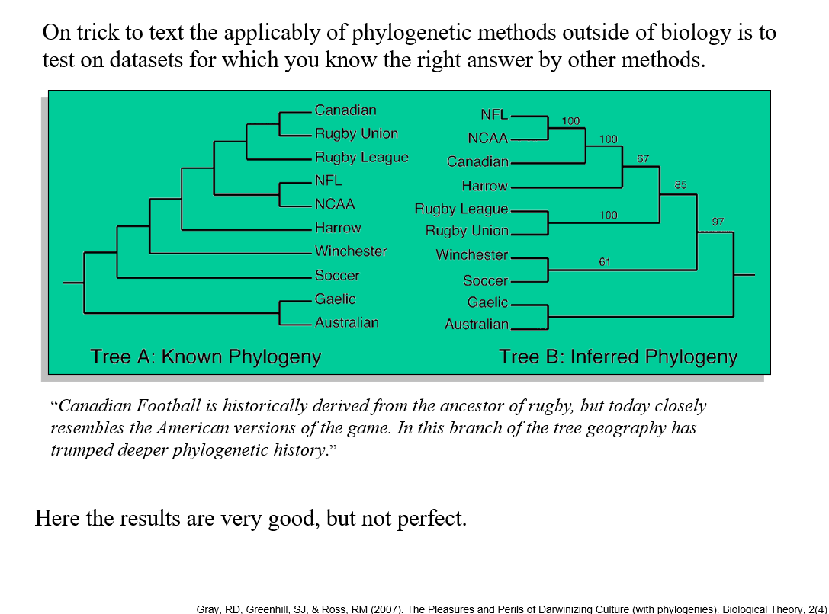

Slide 20
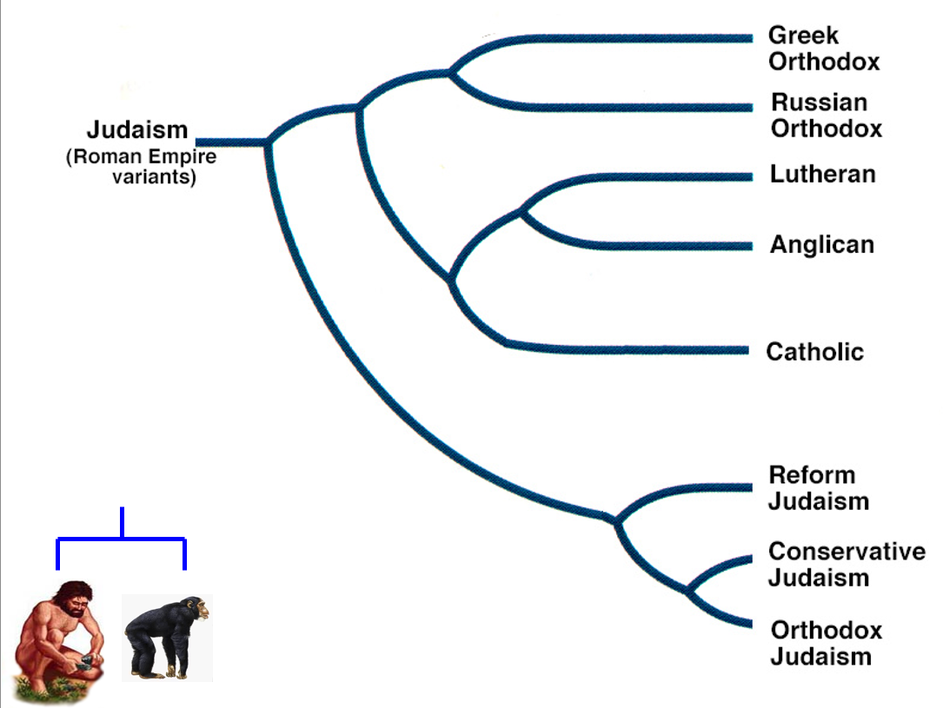

Slide 21
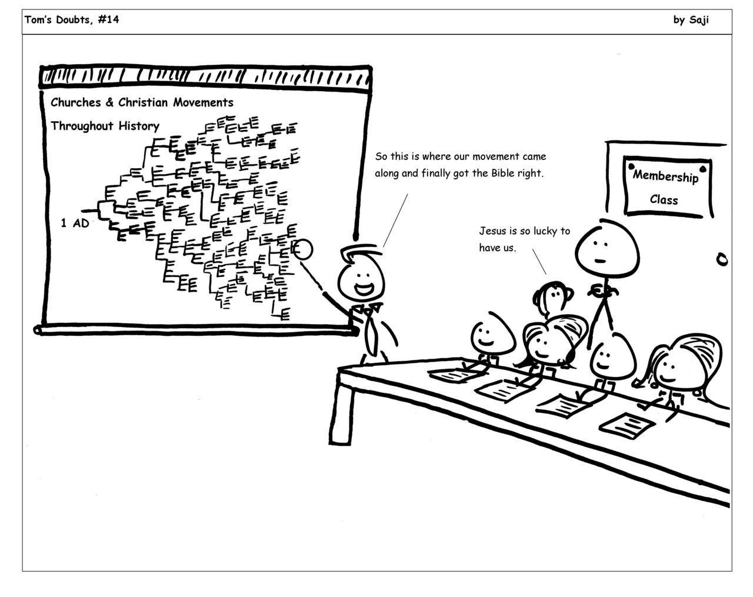

Slide 22
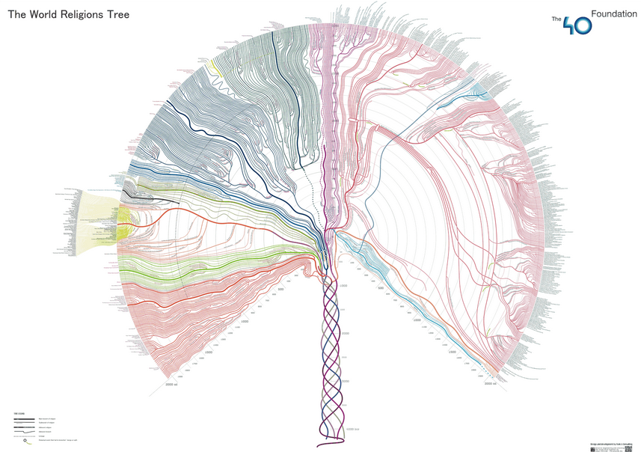
http://000024.org/religions_tree/

Slide 23
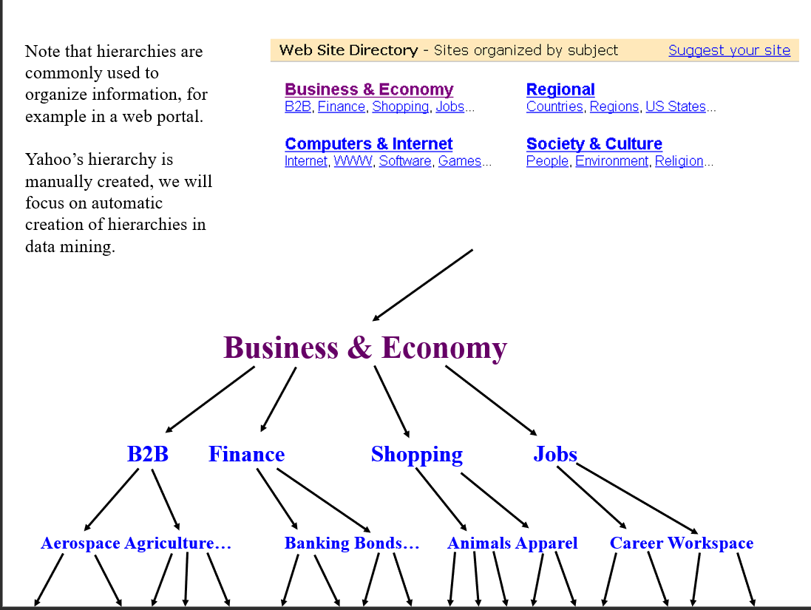

Slide 24
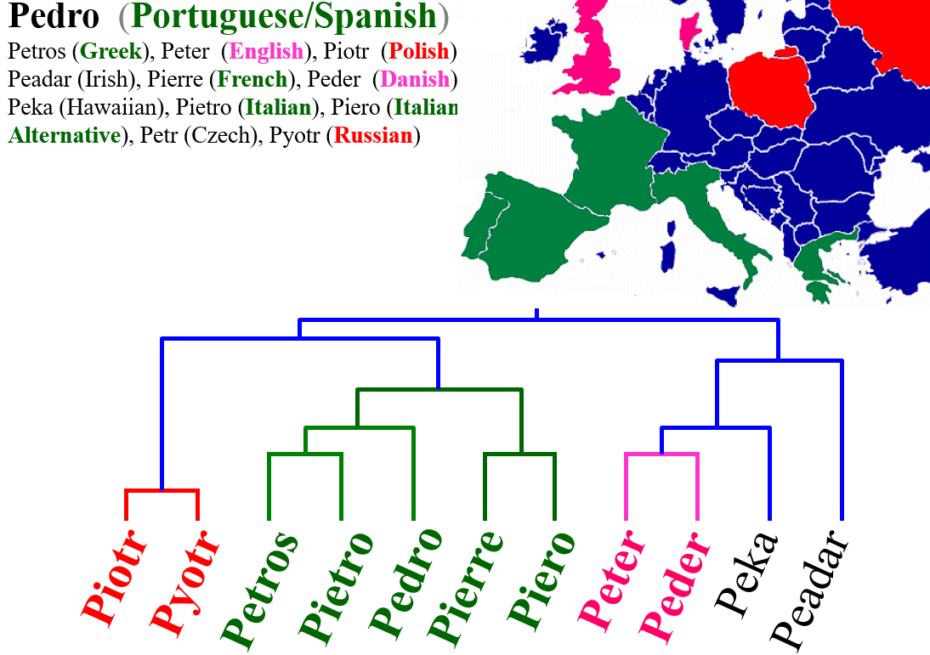

Slide 25
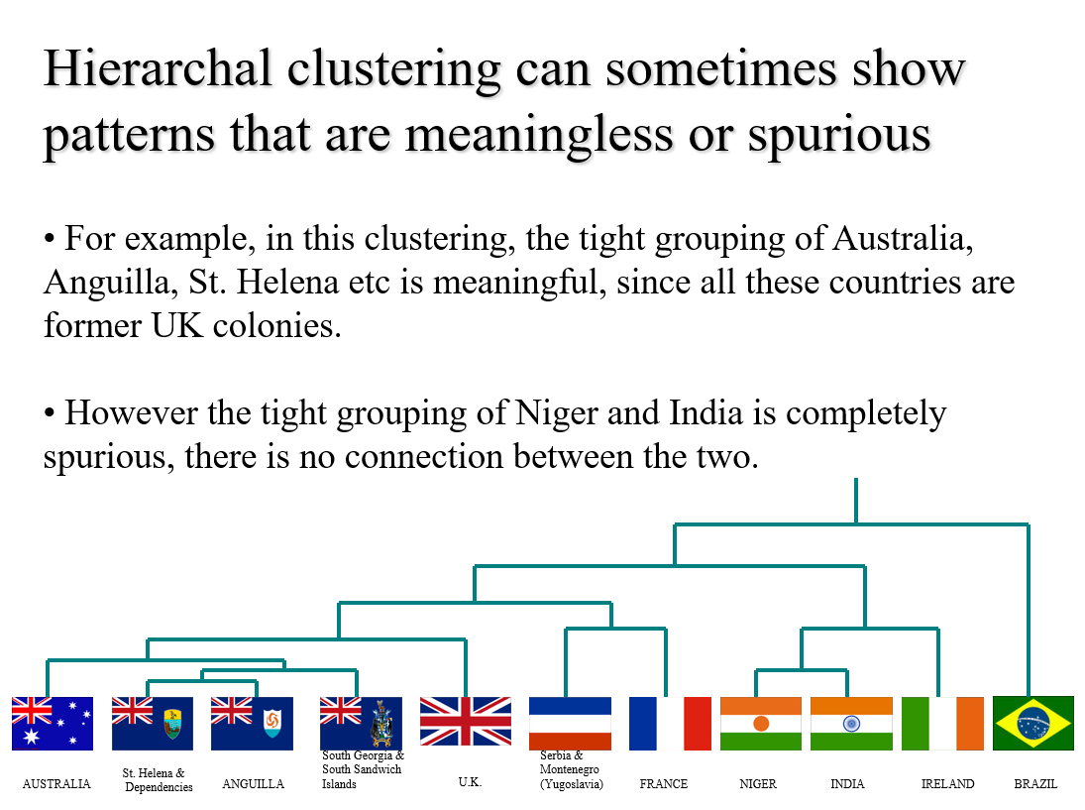

Slide 26
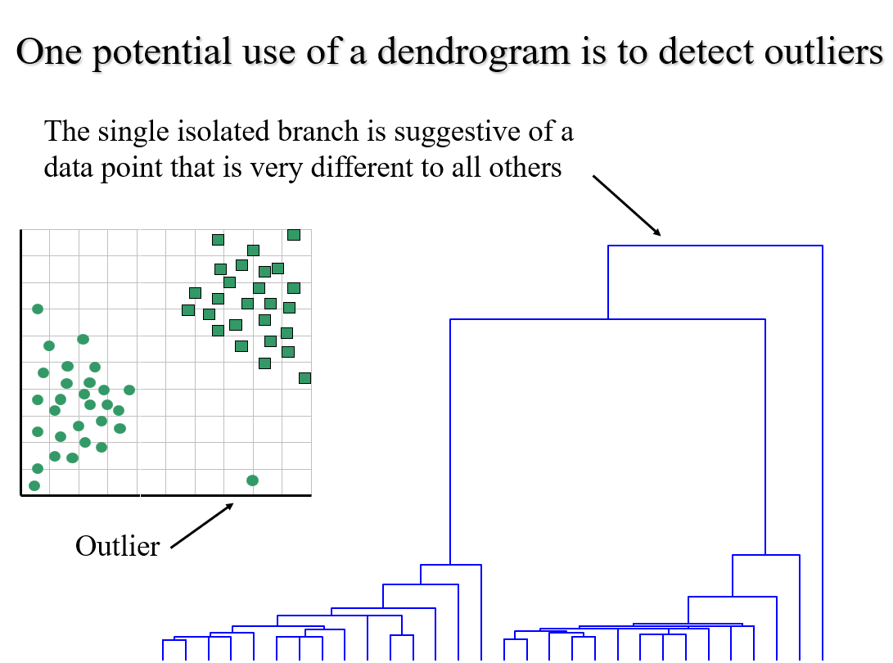

Slide 27
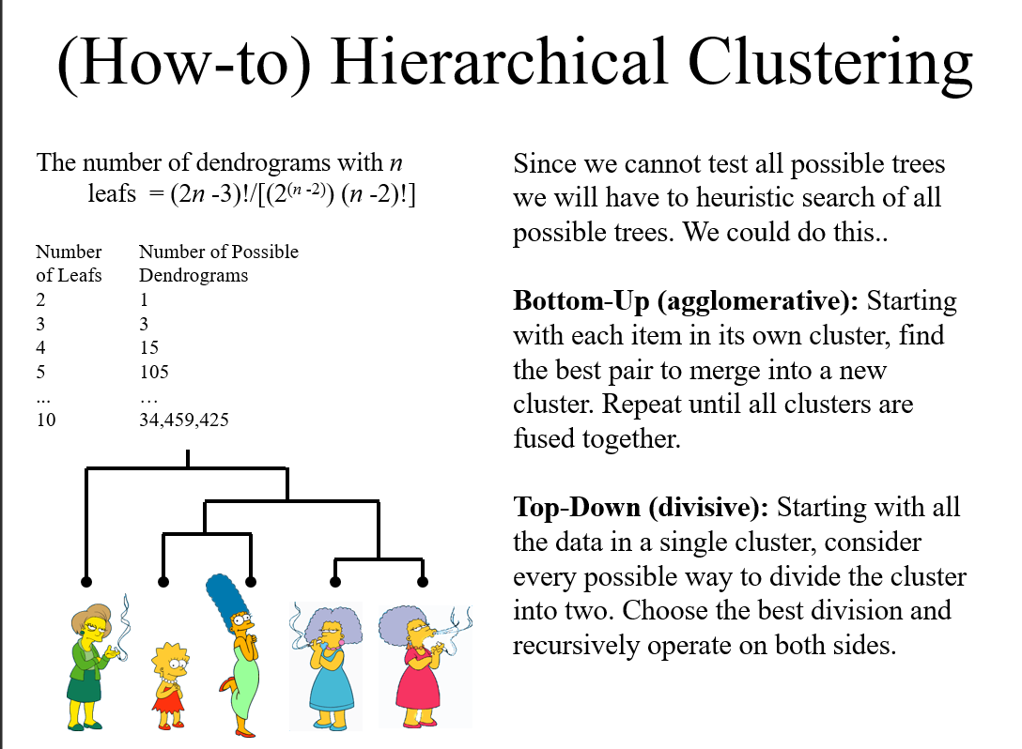

Slide 28
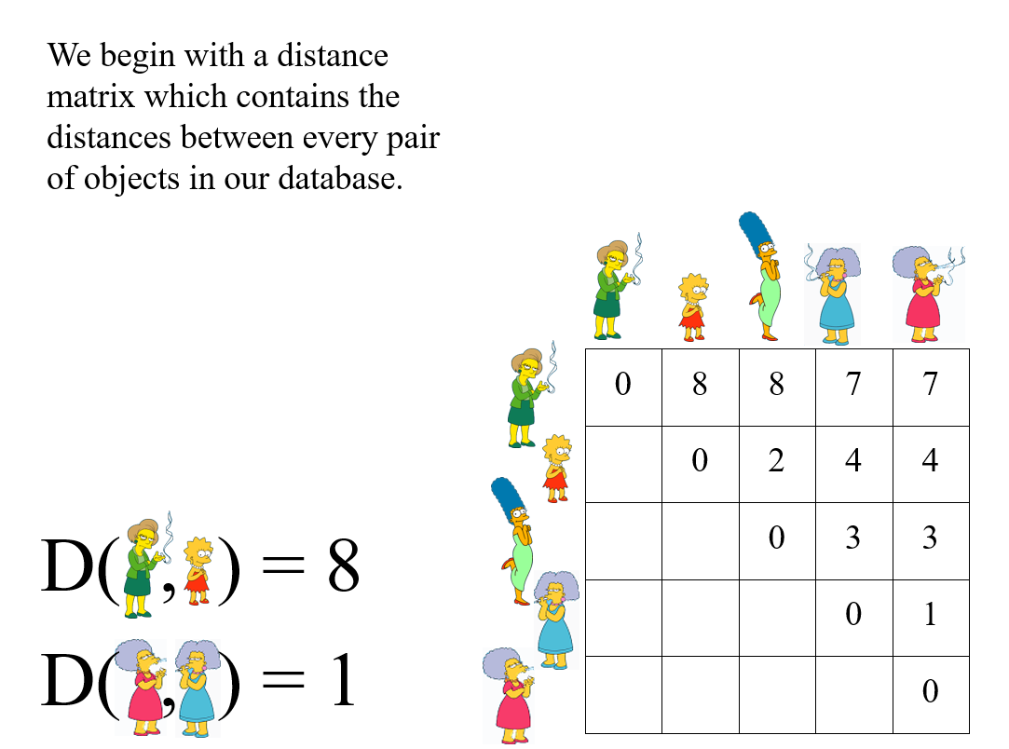

Slide 29
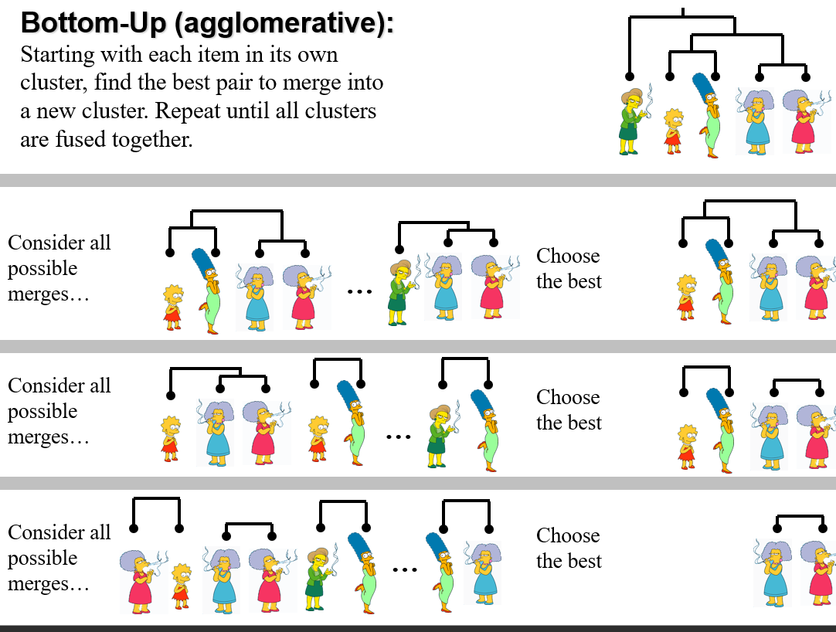

Slide 30
We know how to measure the distance between two objects, but defining the distance between an object and a cluster, or defining the distance between two clusters is non obvious.
Single linkage (nearest neighbor): In this method the distance between two clusters is determined by the distance of the two closest objects (nearest neighbors) in the different clusters.
Complete linkage (furthest neighbor): In this method, the distances between clusters are determined by the greatest distance between any two objects in the different clusters (i.e., by the "furthest neighbors").
Group average linkage: In this method, the distance between two clusters is calculated as the average distance between all pairs of objects in the two different clusters.
Wards Linkage: In this method, we try to minimize the variance of the merged clusters

Slide 31
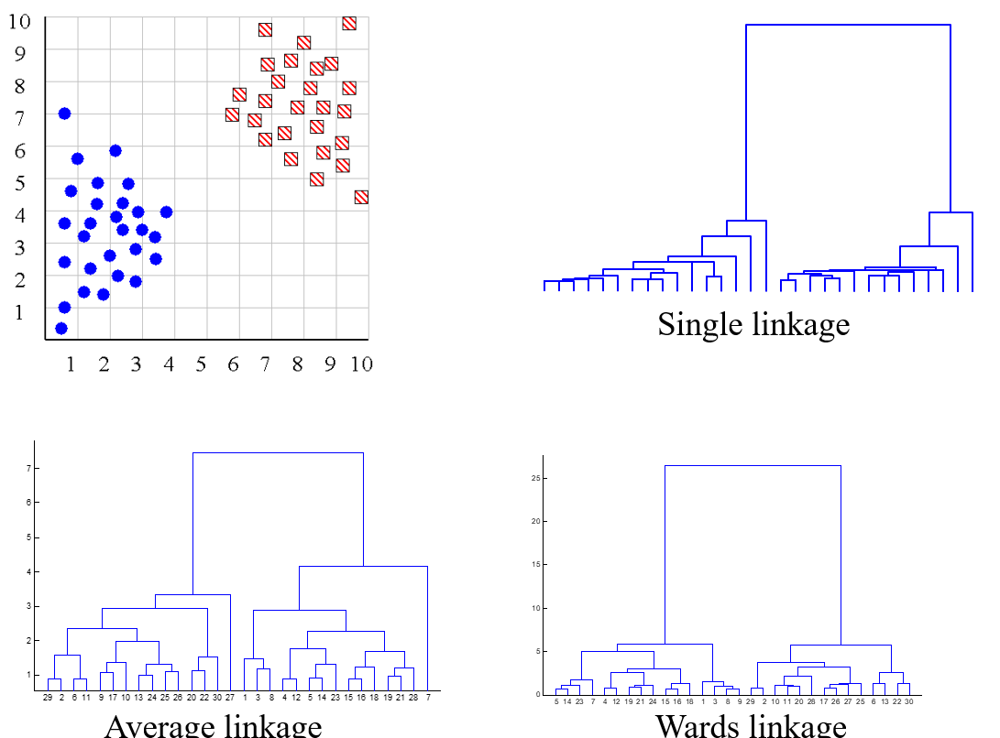

Slide 32
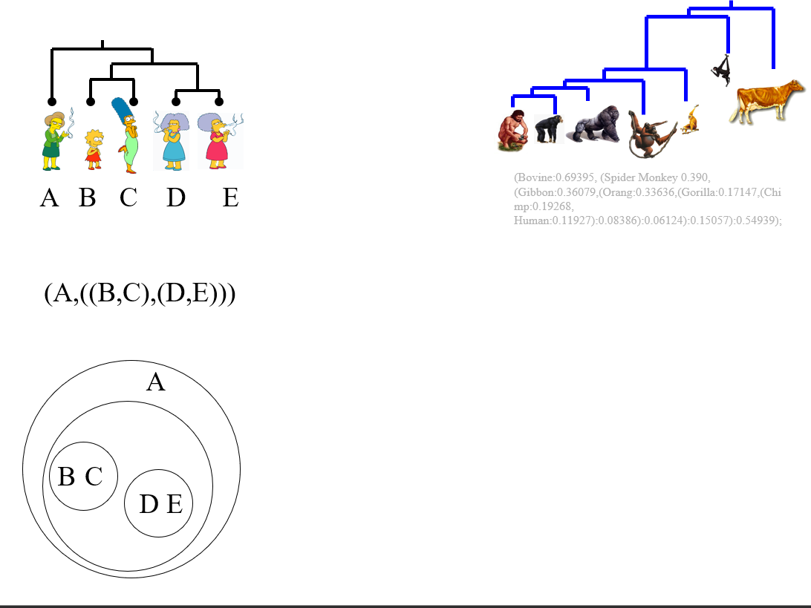

Slide 33
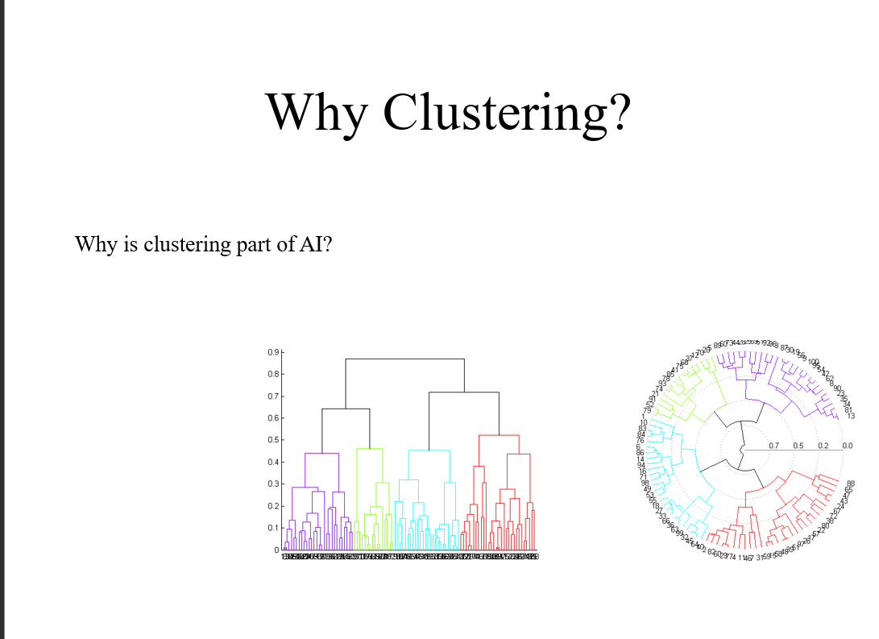

Slide 34
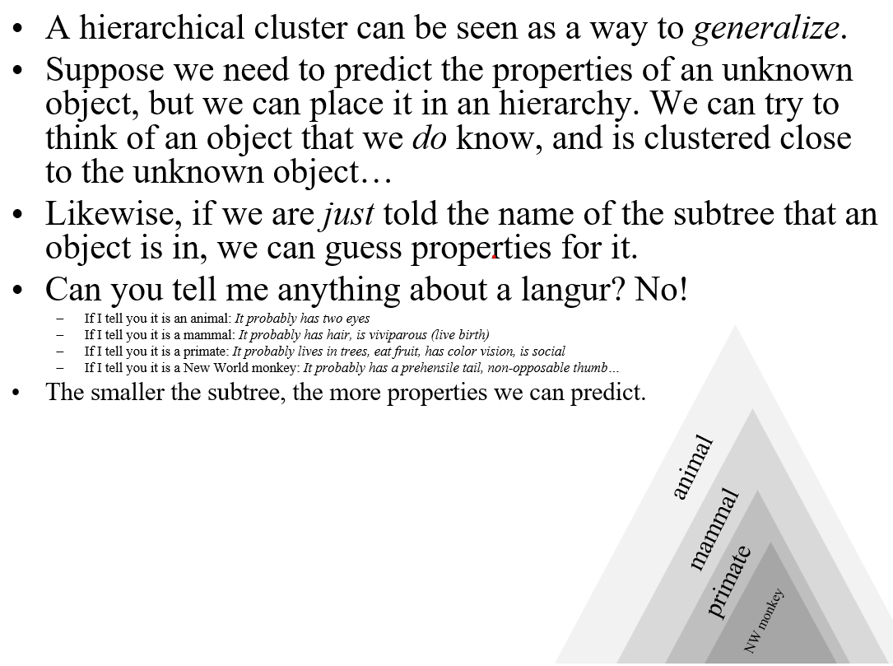

Slide 35
